Slide 1

Automation for QCA
Module 4: Writing Test Scripts

Slide 2
Module 4 Objectives
At the end of this module, participants will be able to understand:
Tests and Test Attributes
Steps and Step Attributes, Parameters
Keywords
Tokens
Functions
Demo

Slide 3

Course Map / Module Map
Module 4
Module 3
Module 2
Module 1
Module 4 Map
Tests
Step
Keywords
Functions
Tokens

Slide 4
Module 4 Design Outline
Test
Keywords
Functions
Steps
Tokens

Slide 5
Module 4 Design Outline
Test
Keywords
Functions
Steps
Tokens

Slide 6

Tests
A test defines a collection of steps to run.
The most commonly used attributes are as follows:
name
active
dataprovider
datadriver
timed
threshold
os
linkid
Testtags
These attributes are discussed in brief in next few slides

Slide 7

Attribute – name
Specifies the name of the test case
Example
Attribute -name

Slide 8
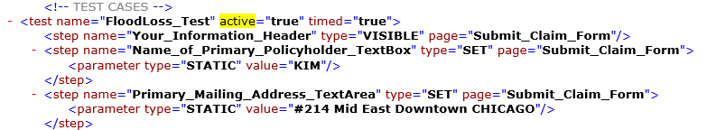
Attribute - active
A flag (true/false) indicating if this test is active. If the value is unspecified or equal to true then the test will be available for execution.
If a test is marked inactive bus is directly called from another test or function then it will still execute.
Attribute –active=“true”

Slide 9
Attribute - dataprovider
Data providers are used to provide named data sets for use in the test case.
Once a data provider has been supplied to a test it will be available during the execution of the test and all functions or tests that are called from it.
You can specify multiple named data providers for a test case.
One record will be selected from each data provided and made available for the test.
To use a specific record from a data store you can use the following format which will select a specific record. recordType.recordName.
Note that specifying a specific record will bypass any locking algorithm associated with this record type

Slide 10
Attribute - datadriver
The Data Driver uses the same underlying logic as the data provider however the test case will iterate and execute over all of the records in the specified data set as apposed to a single record.
Only a single data driver may be specified here. You may use data providers and a data driver in the same test case but specifying both attributes.

Slide 11

Attribute - timed
A flag (true/false) indicating if this test case step should be timed.
Attribute –timed=“true”

Slide 12
Attribute – threshold, os and linkId
threshold: A value indicating a maximum amount of milliseconds allowed for the test case step. If the timed attribute is set to true and the threshold value is great than 0 then the test case would fail if the timed value was greater than the threshold value.
os: An optional value that when specified indicated that this test should only be executed if the OS value of the device matches the OS specified here. This test will be marked as skipped if an OS was specified and it did not match.
linkId: A Link ID is purely for documentation or external integration. The value is not used by any test. This attribute can be used for external integration or information purposes.
Notes:
testtags:Test Tags are used to allow for test grouping. By providing a comma separated list of test tags the test executor can then specify a test tag and only test who contain that tag will run.

Slide 13
Module 4 Design Outline
Test
Keywords
Functions
Steps
Tokens

Slide 14
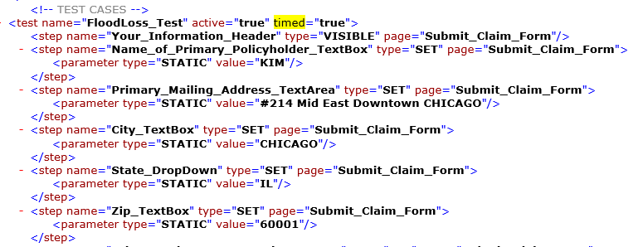
Steps
A test case is made up of a collection of steps. Each of the steps are executed in sequence. If any of the test steps fail, the entire test case will fail.
S
T
E
P
S

Slide 15
Step – Attributes (1 of 4)
A step defines a single test action. A step can one of many different types ranging from testing element values to color verification.
A step can also contains steps as sub elements. Sub steps along with the failure Mode attribute defined below can be combined for conditional logic as the sub steps are only executed if the parent element is successful.

Slide 16
Step – Attributes (2 of 4)
Attribute | Description
Name: | Specifies the name of the element from the object repository
Active: | A flag (true/false) indicating if this step is active. If the value is unspecified or equal to true then the step will execute otherwise it will be skipped without being logged or throwing an error
context: | Context is used to store the result of the step call into a context variable (attribute value) for later use. Once set, the context value can be reference later using the same name
inverse: | A flag (true/false) indicating if the resulting success of this step should be inverted. An inverted step will return true on failure and false on success. The is the same concept as a NOT condition
linkId: | A Link ID is purely for documentation or external integration. The value is not used by any test. This attribute can be used for external integration or information purposes

Slide 17
Step – Attributes (3 of 4)
Attribute | Description
os: | An optional value that when specified indicated that this step should only be executed if the OS value of the device matches the OS specified here.
page: | The name of the page object from the object repository in which the named element is a member of.
poi: | If Wind Tunnel is enabled for this test case, then a point of interest is registered. For a more detailed description of Wind Tunnel, please refer to Perfecto's Wind Tunnel documentation
timed: | A flag (true/false) indicating if this test case step should be timed.
threshold: | A value indicating a maximum amount of milliseconds allowed for the test case step. If the timed attribute is set to true and the threshold value is great than 0 then the test case would fail if the timed value was greater than the threshold value

Slide 18
Step – Attributes (4 of 4)
Attribute | Description
wait: | Wait is a shorthand implementation of the WAIT step. This allows you to specify a value in milliseconds that will wait after this step is complete
failureMode: | Failure Mode allows you to specify what action the step should take following a failure caused by criteria or a error in the step. By default, any failure will fail the entire test case and stop the execution immediately. In addition, you can specify
 | ignore: Ignores the failure and continues on with your test
 | logignore: Logs the failure in the log and continues on with your test
 | error: The default action - this will stop the test and fail
type: | Specifies the step type. A step type defines the action or implementation
validationType: | This optional parameter allows you to specify a validation method to use on the return value of this step. There are multiple types of validation implementations used. That are defined as:
 | REGEX: This will read the value in the validation attribute as a regular expression and attempt to match the value to this regular expression
 | EMPTY: This ensumes that the value is empty
 | NON_EMPTY: The ensures that the value is not empty
Notes:
validation:Used in conjunction with the validationType attribute to perform validation on a field. When the validationType attribute is REGEX this will be the regular expression that is used
device:When working with multiple devices in the same test case this parameter is used to specify the device that you want the step to run against. This device is named using the ADD_DEVICE keyword in a previous step

Slide 19
Example of Step – Attributes
Test Steps for Flood Loss application:-

Slide 20
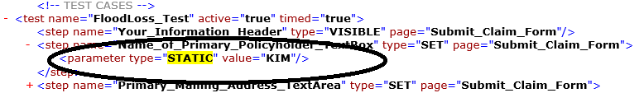
Parameters (1 of 3)
Parameters are passed to step to further define their action (please refer to the documentation of an individual step to determine its need for parameters).
When you are specifying a parameter you specify both a type and a value. The contents of the value are dictated by the type specified

Slide 21
Parameters (2 of 3)
Attribute | Description
static: | The value is to be use as is with no change
data: | The value is a definition for a field from the Page Data engine that was specified in your test case as a data provider or a data driver. The value is specified user the following notation providerName.fieldName where the providerName is the name of the data provider and fieldName is then name of the field in that table. If a tiered data structure is used, you will follow the path using the dot notation and the field names. If your root provider contains a reference to a table using the field carType and you wanted to reference that table it would be rootProvider.carType.
context: | The value specified in this type is the the name of the context variable that was previously set using the context attribute on a previous test. You must match the spelling and case of the context variable name.

Slide 22
Parameters (3 of 3)
Attribute | Description
property: | The value specified in this type is the name of a System Property passed into the execution of the test
content: | The value specified in this type refers to a record from the content engine. That value can be formatted in multiple ways. If you just specify the key name from the content management defined key column then the first value is returned that matches that name. If multiple lookup columns were specified then you can specify an individual column using one of two methods. First, you can specify the column index by using the following format keyName{#columnNumber}. The will find the lookup value array and return the specified column value represented by the index. Otherwise, you can use the column name as specified by the first row in the content data using the following format: keyName{columnName}

Slide 23

Activity 1
Environment or File: M4_Writing TestScripts_Participants Guide
Steps:
Open the Participants Guide given as word document.
Read the given activity details.
Complete the activities
Submit to faculty
Activity

Slide 24
Module 4 Design Outline
Test
Keywords
Functions
Steps
Tokens

Slide 25
Keywords – SET (1 of 2)
The SET keyword is a simple but widely used keyword
This will type a value in textbox .
Also this can be used to select a value from the dropdown
Example(s):This example will click on an element named 'TEST_ELEMENT' from TEST_PAGE
<step name="TEST_ELEMENT" type=“SET" page="TEST_PAGE" />

Slide 26
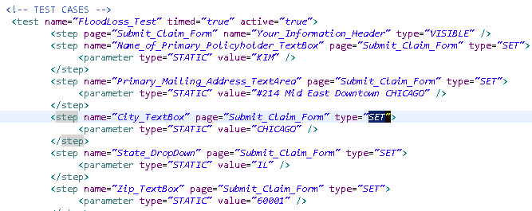
Keywords – SET (2 of 2)
The below shown code snippet is the usage of SET Keyword.
This example illustrates how to set values for Textbox's like “Name_of_primary_Policyholder_Textbox”, “Primary_Mailing_Address_TextArea”,”City_TextBox” and how to select values from the Drop down like “State_DropDown”
Set a value in TextBox
Set a value in DropDown

Slide 27

Set Keyword : Try It
Time Allocated: 30 minutes
Environment - Eclipse
Steps:
Create a folder by name SetKeyword under xmlDriven project in eclipse.
Create registry folder, tests folder, driverConfig.txt, pageElements and Web-Tests.xml under SetKeyword.
Create applicationRegistery.xml, deviceRegistry.xml and cloudRegistry.xml under registry folder.
Configure driverConfig.txt.
Create pageElements.xml for the application under test. In the given activity the application under test is https://www.allstate.com.
Create test-steps.xml under tests folder with implementation of Set keyword as discussed.
Import the test-steps.xml files in to the Web-Test.xml.
To run the test scripts copy the path of driverConfig.txt and give the respective path as command line argument for the TestDriver.java file which is already located in the project AS-TestDriver.
After execution of script the test-output will be created in SetKeyword project.
Explore the test-output folder to see the reports.

Slide 28
Keywords – Click (1 of 2)
The click keyword allows you to locate an element on the screen and click on it.
Example(s):This example will click on an element named 'TEST_ELEMENT' from TEST_PAGE
<step name="TEST_ELEMENT" type="CLICK" page="TEST_PAGE" />

Slide 29
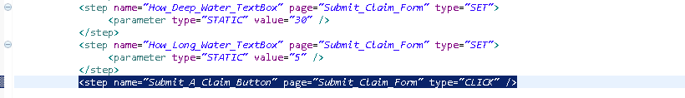
Keywords – Click (2 of 2)
The below shown code snippet shows the usage of Click Keyword.
This example illustrates a click operation on button names as “Submit_A_Claim_Button” in web page “Submit_Claim_Form” in Allstate flood loss application website.

Slide 30
Click Keyword : Try It
Time Allocated: 30 minutes
Environment - Eclipse
Steps:
Create a folder by name ClickKeyword under xmlDriven project in eclipse.
Create registry folder, tests folder, driverConfig.txt, pageElements and Web-Tests.xml underClickKeyword.
Create applicationRegistery.xml, deviceRegistry.xml and cloudRegistry.xml under registry folder.
Configure driverConfig.txt.
Create pageElements.xml for the application under test. In the given activity the application under test is https://www.allstate.com.
Create test-steps.xml under tests folder with implementation of Click keyword as discussed.
Import the test-steps.xml files in to the Web-Test.xml.
To run the test scripts copy the path of driverConfig.txt and give the respective path as command line argument for the TestDriver.java file which is already located in the project AS-TestDriver.
After execution of script the test-output will be created in ClickKeyword project.
Explore the test-output folder to see the reports.

Slide 31
Keywords – Mouse (1 of 2)
The mouse step allows control of specific mouse based events
The Mouse step basically has a single parameter
parameter: The name of the mouse action.
The supported actions are
MOVE_TO: Indicates that the mouse pointer should be moved to the center of the named page element.
PRESS: Press the left mouse button at the center of the named page element
RELEASE: Releases the left mouse button at the center of the named page element.

Slide 32
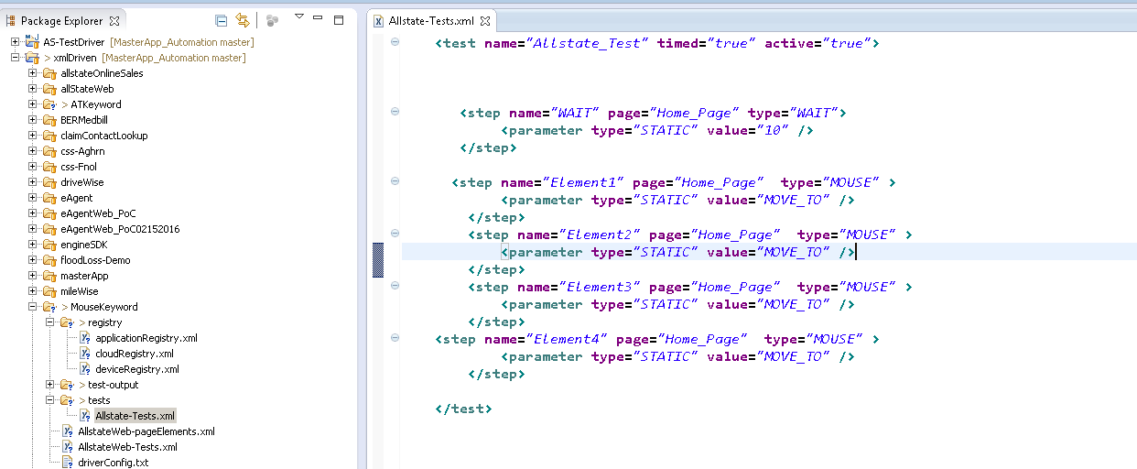
Keywords – Mouse (2 of 2)
The below shown code snippet is the usage of mouse step . This example illustrates how to navigate to different types of Insurance links like Home, Condo, Roadside, Business etc under Insurance & more in allstate.com website.

Slide 33
Mouse Keyword : Try It
Time Allocated: 30 minutes
Environment - Eclipse
Steps:
Create a folder by name MouseKeyword under xmlDriven project in eclipse.
Create registry folder, tests folder, driverConfig.txt, pageElements and Web-Tests.xml under MouseKeyword.
Create applicationRegistery.xml, deviceRegistry.xml and cloudRegistry.xml under registry folder.
Configure driverConfig.txt.
Create pageElements.xml for the application under test. In the given activity the application under test is https://www.allstate.com.
Create test-steps.xml under tests folder with implementation of mouse keyword as discussed.
Import the test-steps.xml files in to the Web-Test.xml.
To run the test scripts copy the path of driverConfig.txt and give the respective path as command line argument for the TestDriver.java file which is already located in the project AS-TestDriver.
After execution of script the test-output will be created in MouseKeyword project.
Explore the test-output folder to see the reports.

Slide 34
Keywords – ATTRIBUTE (1 of 3)
The attribute step allows the script engineer to extract and/or compare the value of any named XML/HTML attribute from the named page element.
When a single parameter is specified, the attribute is extracted only and can optionally be stored as a context variable.
When supplying 2 parameters the first parameter represents the value to compare to and the second is the name of the attribute.
When defining the attribute name you may optionally precede the name with STYLE which instructs the engine to extract the named style from this element in place of the attribute value
When passing a single parameter
The name of the style or attribute that you wish to extract. To extract a style the name must be preceded with STYLE
Extract the WIDTH value from the MY_ELEMENT element on the MENU page and store it as ATTR_WIDTH for later use

Slide 35
Keywords – ATTRIBUTE (2 of 3)
Example 1
<step type="ATTRIBUTE" name="MY_ELEMENT" page="MENU" context="ATTR_WIDTH">
<parameter type="STATIC" value="WIDTH" />
</step>
Extract the WIDTH value from the MY_ELEMENT element on the MENU page and compare it to the static value 100
Example 2
<step type="ATTRIBUTE" name="MY_ELEMENT" page="MENU">
<parameter type="STATIC" value="100" />
<parameter type="STATIC" value="WIDTH" />
</step>

Slide 36
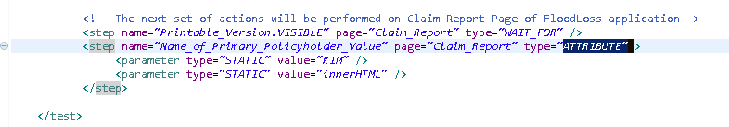
Keywords – ATTRIBUTE (3 of 3)
The below shown code snippet is the usage of Attribute Keyword.

Slide 37
Attribute Keyword : Try It
Time Allocated: 30 minutes
Environment - Eclipse
Steps:
Create a folder by name AttributeKeyword under xmlDriven project in eclipse.
Create registry folder, tests folder, driverConfig.txt, pageElements and Web-Tests.xml under AttributeKeyword.
Create applicationRegistery.xml, deviceRegistry.xml and cloudRegistry.xml under registry folder.
Configure driverConfig.txt.
Create pageElements.xml for the application under test. In the given activity the application under test is https://www.allstate.com.
Create test-steps.xml under tests folder with implementation of Attribute keyword as discussed.
Import the test-steps.xml files in to the Web-Test.xml.
To run the test scripts copy the path of driverConfig.txt and give the respective path as command line argument for the TestDriver.java file which is already located in the project AS-TestDriver.
After execution of script the test-output will be created in AttributeKeyword project.
Explore the test-output folder to see the reports.

Slide 38
Keywords – AT (1 of 2)
The AT keyword allows you to extract the current position and dimension of the specified element and store that information in CONTEXT variables for later use.
The element does not validate the position however it will validate the existence of the element. If a CONTEXT name is specified, 4 context variables will be created as specified below.
Note if context name is NOT specified then the element name will be used in place of the context name.
[contextName].x - The X position of the top left corner of the element
[contextName].y - The Y position of the top left corner of the element
[contextName].width - The width of the element
[contextName].height - The height of the element

Slide 39
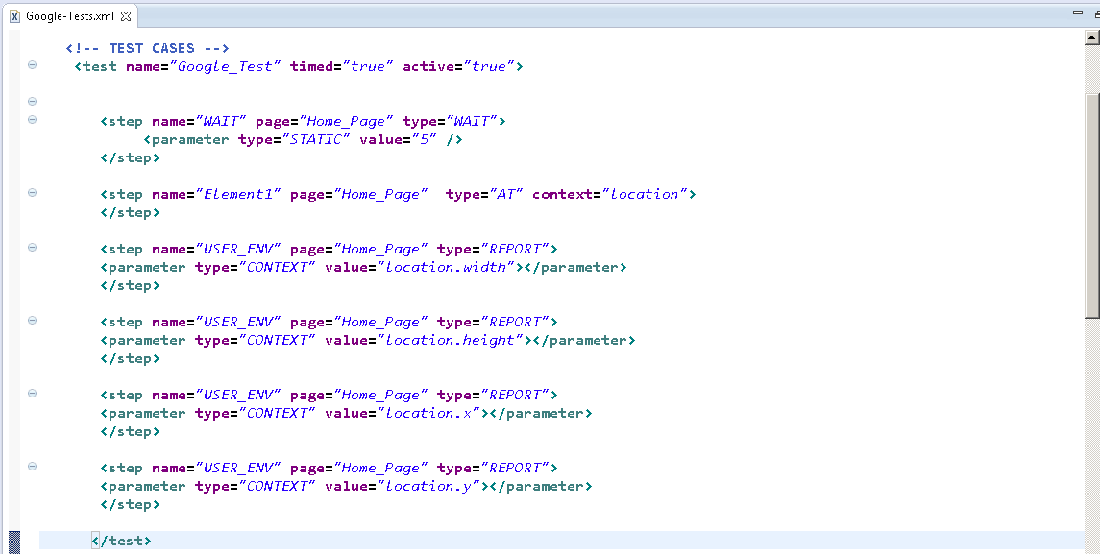
Keywords – AT (2 of 2)
The below shown code snippet is the usage of AT step . This example illustrates
how to check dimension and point of Google Logo and display height, width, x and y coordinate in the report for www.google.co.in
Notes:
type=“REPORT” is used to append data to the generated output.

Slide 40
AT Keyword : Try It
Time Allocated: 30 minutes
Environment - Eclipse
Steps:
Create a folder by name ATKeyword under xmlDriven project in eclipse.
Create registry folder, tests folder, driverConfig.txt, pageElements and Web-Tests.xml under ATKeyword.
Create applicationRegistery.xml, deviceRegistry.xml and cloudRegistry.xml under registry folder.
Configure driverConfig.txt.
Create pageElements.xml for the application under test. In the given activity the application under test is https://www.google.co.in/
Create test-steps.xml under tests folder with implementation of AT keyword as discussed.
Import the test-steps.xml files in to the Web-Test.xml.
To run the test scripts copy the path of driverConfig.txt and give the respective path as command line argument for the TestDriver.java file which is already located in the project AS-TestDriver.
After execution of script the test-output will be created in ATKeyword project.
Explore the test-output folder to see the reports.

Slide 41
Keywords – EXECJS (1 of 2)
The EXECJS keyword allows for JavaScript code to be passed and executed on the browser, which supports JavascriptExecutor API of Selenium WebDriver. The code will be passed through and executed on browser.
The only single parameter passed to the function is the actual Javascript code that has to execute
parameter : Javascript code

Slide 42
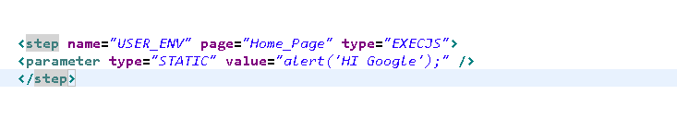
Keywords – EXECJS (2 of 2)
The below shown code snippet is the usage of EXECJS step . This example illustrates how to pass and execute javascript code in google.co.in website

Slide 43
EXECJS Keyword : Try It
Time Allocated: 30 minutes
Environment - Eclipse
Steps:
Create a folder by name EXECJSKeyword under xmlDriven project in eclipse.
Create registry folder, tests folder, driverConfig.txt, pageElements and Web-Tests.xml under EXECJSKeyword.
Create applicationRegistery.xml, deviceRegistry.xml and cloudRegistry.xml under registry folder.
Configure driverConfig.txt.
Create pageElements.xml for the application under test. In the given activity the application under test is https://www.google.co.in/
Create test-steps.xml under tests folder with implementation of EXECJS keyword as discussed.
Import the test-steps.xml files in to the Web-Test.xml.
To run the test scripts copy the path of driverConfig.txt and give the respective path as command line argument for the TestDriver.java file which is already located in the project AS-TestDriver.
After execution of script the test-output will be created in EXECJSKeyword project.
Explore the test-output folder to see the reports.

Slide 44
Keywords – COMPARE (1 of 2)
The compare keyword takes 2 parameter values and compares them together. If they are the same then the test passes.
There are 2 required parameters for the compare function. Both parameters will be evaluated and compare to each other to ensure that they are equal.
parameter1 : to compare (expected)
Parameter2 : to compare (actual)

Slide 45
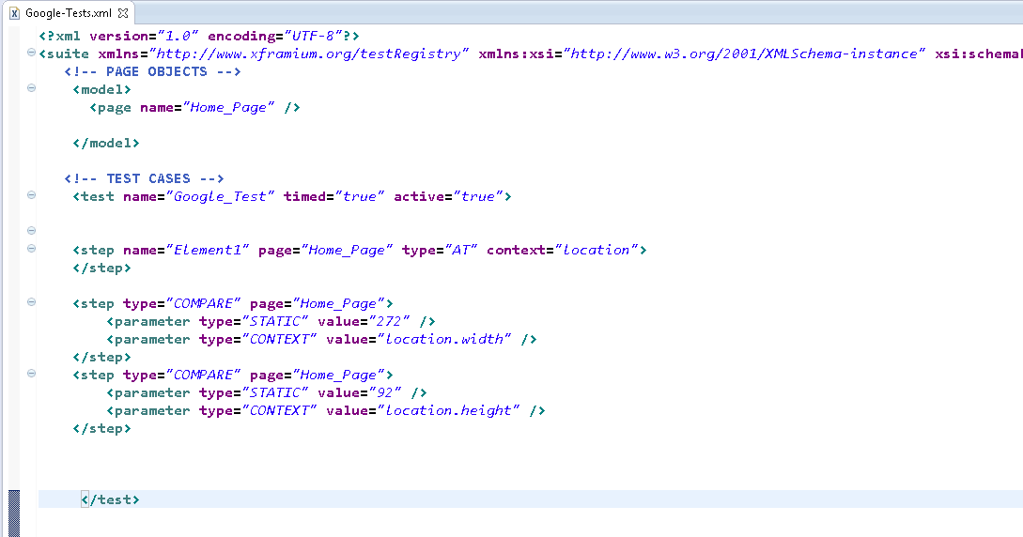
Keywords – COMPARE (2 of 2)
The below shown code snippet is the usage of COMPARE step . This example illustrates how to compare height and width of Google logo

Slide 46
COMPARE Keyword : Try It
Time Allocated: 30 minutes
Environment - Eclipse
Steps:
Create a folder by name COMPAREKeyword under xmlDriven project in eclipse.
Create registry folder, tests folder, driverConfig.txt, pageElements and Web-Tests.xml under COMPAREKeyword.
Create applicationRegistery.xml, deviceRegistry.xml and cloudRegistry.xml under registry folder.
Configure driverConfig.txt.
Create pageElements.xml for the application under test. In the given activity the application under test is https://www.google.co.in/
Create test-steps.xml under tests folder with implementation of COMPARE keyword as discussed.
Import the test-steps.xml files in to the Web-Test.xml.
To run the test scripts copy the path of driverConfig.txt and give the respective path as command line argument for the TestDriver.java file which is already located in the project AS-TestDriver.
After execution of script the test-output will be created in COMPAREKeyword project.
Explore the test-output folder to see the reports.

Slide 47
Keywords - OPEN_PAGE ( 1of 2)
OPEN_PAGE keyword is used for navigating from current page to different page.
This keyword step is similar to navigateTo() of webdriver API.
OPEN_PAGE step accepts only one String parameter value.
parameter 1: URL of the web page

Slide 48
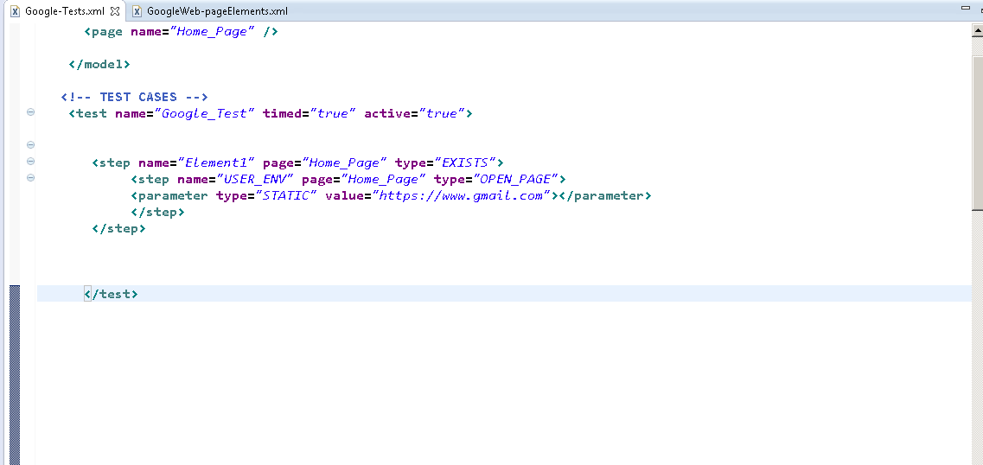
OPEN_PAGE Step Code Snippet
The below shown code snippet is the usage of OPEN_PAGE step . This example illustrates how to navigate to Google’s mail page , on the existence of Gmail link in google home page.

Slide 49
OPEN_PAGE Keyword : Try It
Time Allocated: 30 minutes
Environment - Eclipse
Steps:
Create a folder by name OPEN_PAGEKeyword under xmlDriven project in eclipse.
Create registry folder, tests folder, driverConfig.txt, pageElements and Web-Tests.xml under OPEN_PAGEKeyword.
Create applicationRegistery.xml, deviceRegistry.xml and cloudRegistry.xml under registry folder.
Configure driverConfig.txt.
Create pageElements.xml for the application under test. In the given activity the application under test is https://www.google.co.in/
Create test-steps.xml under tests folder with implementation of OPENPAGE keyword as discussed.
Import the test-steps.xml files in to the Web-Test.xml.
To run the test scripts copy the path of driverConfig.txt and give the respective path as command line argument for the TestDriver.java file which is already located in the project AS-TestDriver.
After execution of script the test-output will be created in OPEN_PAGEKeyword project.
Explore the test-output folder to see the reports.

Slide 50
Keyword - WAIT_FOR (1 of 2)
The WAIT_FOR keyword allows the Test Element to wait for some time and then to perform an Operation.
It is used to pause for some period of time in order to proceed further.
Example(s):This example will Wait For an element named 'TEST_ELEMENT' from TEST_PAGE
<step name="TEST_ELEMENT.Operation" type=“WAIT_FOR" page="TEST_PAGE" />

Slide 51
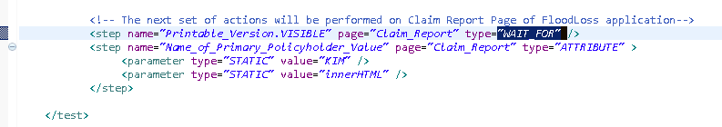
Keyword - WAIT_FOR (2 of 2)
The below shown code snippet is the usage of WAIT_FOR Keyword.
This example illustrates how to use “WAIT_FOR” keyword on Printable_Version test element which is to be VISIBLE after certain period of time.

Slide 52
WAIT_FOR Keyword : Try It
Time Allocated: 30 minutes
Environment - Eclipse
Steps:
Create a folder by name WaitForKeyword under xmlDriven project in eclipse.
Create registry folder, tests folder, driverConfig.txt, pageElements and Web-Tests.xml under WaitForKeyword.
Create applicationRegistery.xml, deviceRegistry.xml and cloudRegistry.xml under registry folder.
Configure driverConfig.txt.
Create pageElements.xml for the application under test. In the given activity the application under test is https://www.allstate.com.
Create test-steps.xml under tests folder with implementation of WaitFor keyword as discussed.
Import the test-steps.xml files in to the Web-Test.xml.
To run the test scripts copy the path of driverConfig.txt and give the respective path as command line argument for the TestDriver.java file which is already located in the project AS-TestDriver.
After execution of script the test-output will be created in WaitForKeyword project.
Explore the test-output folder to see the reports.

Slide 53
Keywords - Cookie
Cookie is a small textual information stored in browser. Cookie basically stores user preferences, so that when user visits next time browser remembers the user preferences.
ETRM Framework introduces 5 keywords under Cookie Concept.
ADD_COOKIE
GET_COOKIE
GET_COOKIES
DELETE_COOKIE
DELETE_COOKIES

Slide 54
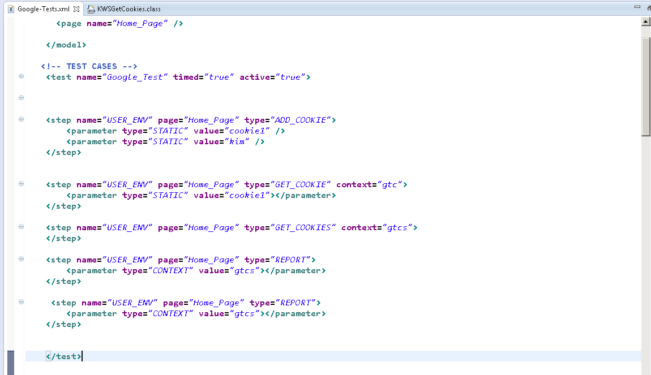
Cookie Implementation Code Snippet
The below shown code snippet is the usage of ADD_COOKIE, GET_COOKIE, GET_COOKIES keywords. This example illustrates how to add and get cookie information from/to browser.

Slide 55
ADD/GET_COOKIE Keyword : Try It
Time Allocated: 30 minutes
Environment - Eclipse
Steps:
Create a folder by name COOKIEKeyword under xmlDriven project in eclipse.
Create registry folder, tests folder, driverConfig.txt, pageElements and Web-Tests.xml under COOKIEKeyword.
Create applicationRegistery.xml, deviceRegistry.xml and cloudRegistry.xml under registry folder.
Configure driverConfig.txt.
Create pageElements.xml for the application under test. In the given activity the application under test is https://www.google.co.in/
Create test-steps.xml under tests folder with implementation of ADD_COOKIE, GET_COOKIE, GET_COOKIES keyword as discussed.
Import the test-steps.xml files in to the Web-Test.xml.
To run the test scripts copy the path of driverConfig.txt and give the respective path as command line argument for the TestDriver.java file which is already located in the project AS-TestDriver.
After execution of script the test-output will be created in COOKIEKeyword project.
Explore the test-output folder to see the reports.

Slide 56
Module 4 Design Outline
Test
Keywords
Functions
Steps
Tokens

Slide 57
Functions (1 of 5)
A test defines a collection of steps to run. Tests and Functions are almost identical. The only differences as that Tests that are marked active will execute where functions must be called the same as inactive tests. We need to create a function as shown below.
<function name="Enter_PrimaryPolicyholderDetails" dataProvider="PrimaryPolicyholderDetails">
<step name="Your_Information_Header" page="Submit_Claim_Form" type="VISIBLE" />
<step name="Name_of_Primary_Policyholder_TextBox" page="Submit_Claim_Form" type="SET">
<parameter type="DATA" value="PrimaryPolicyholderDetails.NameofPrimaryPolicyholder" />
</step>
</function>

Slide 58
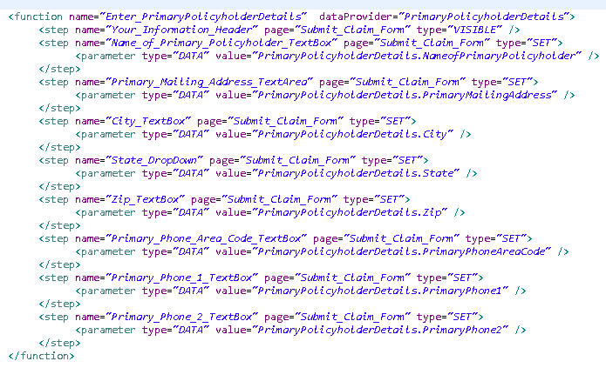
Functions (2 of 5)
Screen shot of the actual code snippet is given below

Slide 59
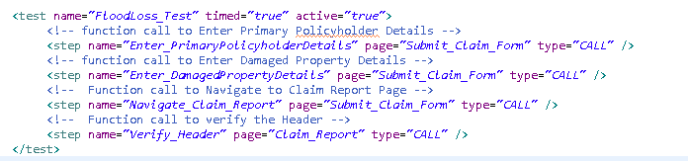
Functions (3 of 5)
Function call to enter page element details is given in the below screen shot.
Note: The attribute type should be type=“CALL” when we make any function call.

Slide 60
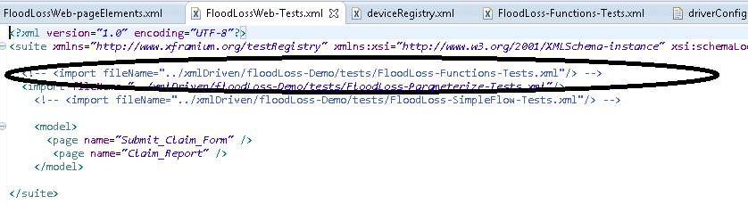
Functions (4 of 5)
Import appropriate –Functions-tests.xml file in Web-Tests.xml file

Slide 61
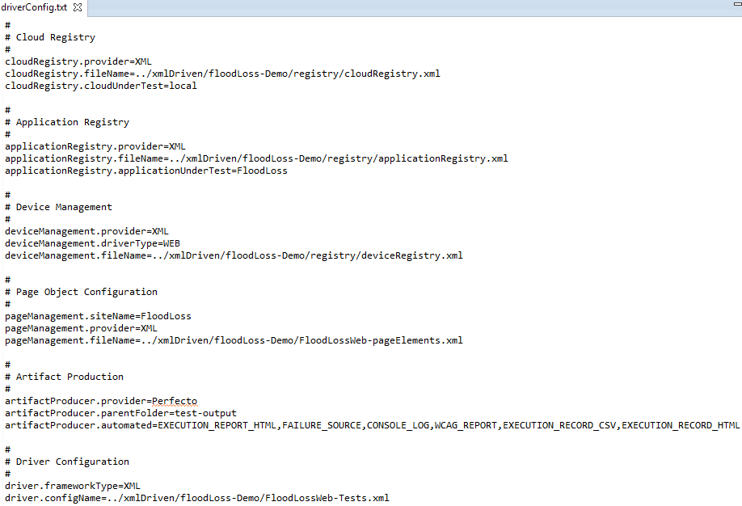
Functions (5 of 5)
Check appropriate configurations have done at driverConfig.txt.The functions-tests.xml is ready for execution.

Slide 62
Activity 2
Environment or File: M4_Writing TestScripts_Participants Guide
Steps:
Open the Participants Guide given as word document.
Read the given activity details.
Complete the activities
Submit to faculty
Activity

Slide 63
Module 4 Design Outline
Test
Keywords
Functions
Steps
Tokens

Slide 64
Tokens (1 of 3)
The token engines allows for on the fly token replacement of values.
Any value specified in the Object Repository is subject to token replacement. Token replacement allows for data driven page element identification reducing the amount of element definition required while enhancing the test case.
When defining a page element you would specify a named token specified as {tokenName}.
One defined, you would then specify the token in your test case with that value that it will be replacing.
The token engine will then use the name attribute in the token element to find the named token then use a combination of the type and value attributes to find the value.
We can specify multiple tokens per element and named tokens that are not found will not be replaced.

Slide 65
Tokens (2 of 3)
Attribute | Description
static: | The value is to be use as is with no change
data: | The value is a definition for a field from the Page Data engine that was specified in your test case as a data provider or a data driver. The value is specified user the following notation providerName.fieldName where the providerName is the name of the data provider and fieldName is then name of the field in that table. If a tiered data structure is used, you will follow the path using the dot notation and the field names. If your root provider contains a reference to a table using the field carType and you wanted to reference that table it would be rootProvider.carType.
context: | The value specified in this type is the name of the context variable that was previously set using the context attribute on a previous test. You must match the spelling and case of the context variable name.
property: | The value specified in this type is the name of a System Property passed into the execution of the test

Slide 66
Tokens (3 of 3)
Attribute | Description
content: | The value specified in this type refers to a record from the content engine. That value can be formatted in multiple ways. If you just specify the key name from the content management defined key column then the first value is returned that matches that name. If multiple lookup columns were specified then you can specify an individual column using one of two methods. First, you can specify the column index by using the following format keyName{#columnNumber}. The will find the lookup value array and return the specified column value represented by the index. Otherwise, you can use the column name as specified by the first row in the content data using the following format: keyName{columnName}

Slide 67
Summary
At the end of this module, participants are able to understand:
Writing test scripts with respect to test steps
Step, Attributes, Implementing parameterization
Functions
Tokens

Slide 68


